Slide 1
DMart Grocery Sales Data Analysis (2015–2018)

Slide 2
1. Introduction
This project focuses on analyzing DMart Grocery Sales data from the years 2015 to 2018. The main objective is to study sales performance, profit trends, category-wise contribution, regional sales distribution, and time-based patterns using Excel data analysis and visualization techniques.

Slide 3
2. Objectives of the Project
To analyze total sales and total profit of DMart grocery business To understand category-wise sales and profit contribution to identify region-wise and city-wise sales performance To analyze sales patterns by days and years To create an interactive Excel dashboard for decision making

Slide 4
3. Dataset Description
The dataset includes the following key fields:
Order Date (Year-wise data from 2015 to 2018)
City and Region Product
Category and Sub-Category
Sales Amount
Profit Amount
The data represents grocery retail transactions across different cities and regions.

Slide 5
4. Tools and Techniques Used
Microsoft Excel
Pivot Tables and Pivot Charts
Slicers for interactivity (City, Year, Sub-Category)
Charts: Column Chart, Pie Chart, Line Chart, Bar Chart
Data Cleaning and Formatting

Slide 6
5.Dashboard Overview
The Excel dashboard provides a consolidated view of sales performance using multiple visual elements:
5.1 Category of Sales
A column chart shows sales contribution across product categories such as Food Grains, Snacks, Beverages, Dairy, and others. This helps identify top-performing categories.
5.2 Category of Profits
A bar chart represents profit earned from different product categories, allowing comparison between high-sales and high-profit categories.
5.3 Region of Sales
A pie chart displays sales distribution across regions (North, South, East, West, and Central), helping understand regional demand patterns.
5.4 Days of Sales
A horizontal bar chart analyzes sales by days of the week, identifying peak sales days.
5.5 Yearly Profit Trend
A line chart shows year-wise profit trends from 2015 to 2018, indicating business growth and fluctuations.
5.6 KPI Cards
Total Sales: ₹1,49,56,982 & Total Profit: ₹37,47,121

Slide 7
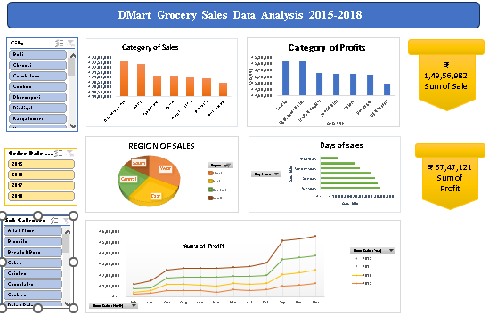

Slide 8
6. Key Insights
Certain categories contribute significantly more to total sales and profits
Sales performance varies across regions, with some regions dominating revenue
Weekdays show different sales patterns compared to weekends
Overall profit shows an increasing trend over the years

Slide 9
7. Conclusion
The DMart Grocery Sales Data Analysis project demonstrates how Excel can be effectively used for business analysis and visualization. The interactive dashboard helps stakeholders quickly understand performance metrics and make data-driven decisions. This project highlights the importance of data analysis in retail business strategy.

Slide 10
8. Future Scope
Integration with Power BI for advanced analytics
Forecasting future sales using trend analysis
Customer-level analysis for personalized marketing

